Slide 1

BUSINESS PLAN FOR SANSKATSU
Abdillah mufki auzan mubin 40621100046 – TEKNIK INFORATIKA

Slide 2


A BUSINESS PLAN FOR SANSKATSU.
Lusiyona Digital Marketing for 5 years lusi05@gmail.com
Abdillah Mufki Auzan Mubin Technology Industry for 6 years
abdillahmufky123@gmail.com

Slide 3
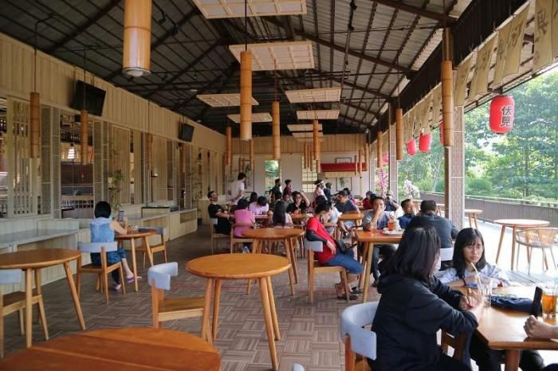
Target Market
The main market segments are :
Target Market Students, and the general public Visitors to the exhibition at every event Office workers whose working hours are busy so it is difficult to go out for lunch. at an affordable price and also a strategic place close to schools and offices

Slide 4
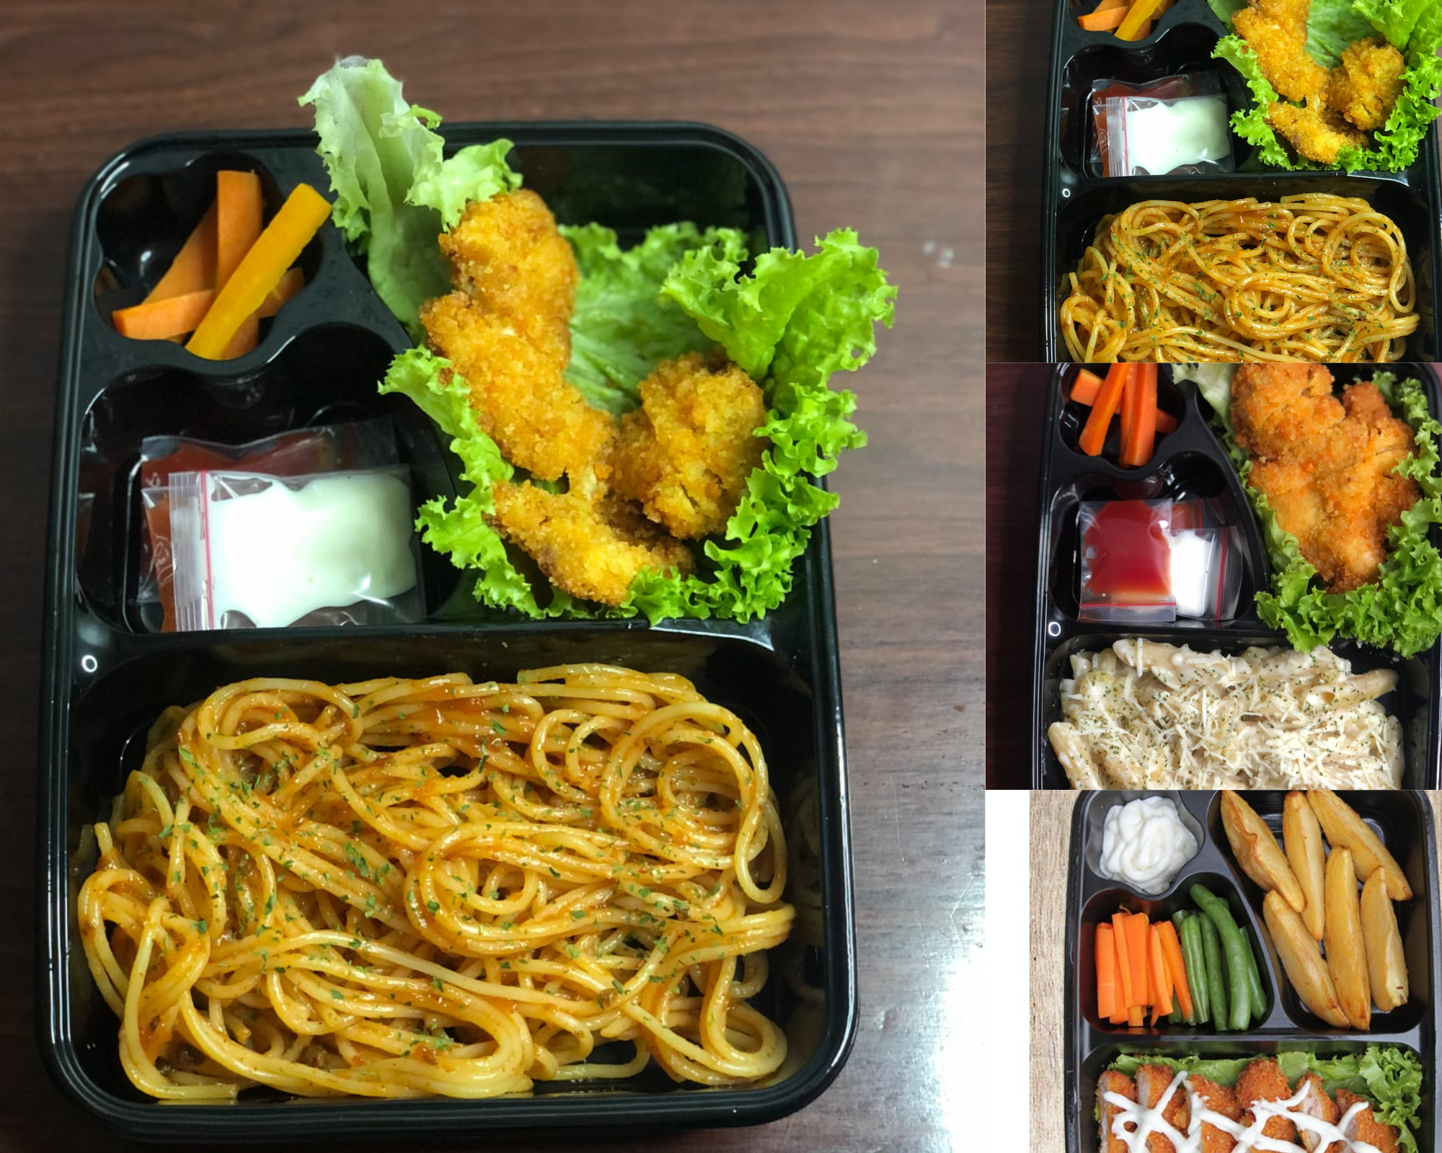
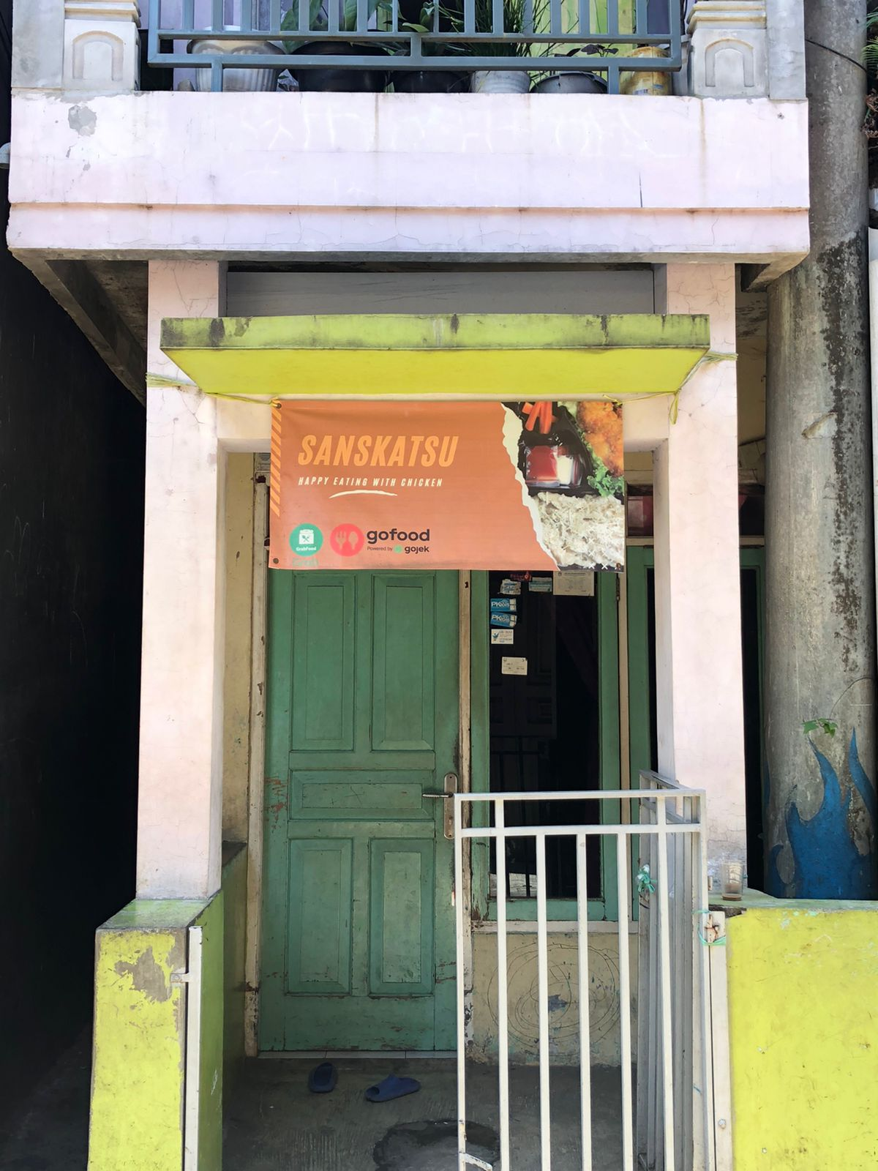
STRATEGIES
A variety of chiken katsu
Infrastructure

Slide 5
SALES FORECAST

Slide 6
PROBLEM
RECOMMENDATION
Food security is one of the main ethical issues in food service. Since food is at the center of every restaurant, you should treat it with the utmost care. As a restauranteur, you can encounter many food transportation issues such as the items not arriving on time, needing temperature-controlled transportation, or being contaminated. These can lead to other poor food safety problems like customers or staff getting sick. Restaurant problems that have to do with food have to be tackled one step at a time. First, find a trustworthy food transportation company in your area. Take your time researching a few to find one that won’t break the bank but also won’t compromise on quality.
Maintain the quality of food/beverage in your culinary business when it comes to the culinary business, the focus is on the quality of food/beverages. if the food you serve is not tasty and not clean, especially if the price is expensive, the chances of customers coming back will be very small. Therefore, the taste and cleanliness of food must be maintained, starting from the selection of good and fresh ingredients to processing and serving it must meet good and proper standards.To be better remembered, it's better if you create food with a distinctive, unique taste, don't follow the current trend. that way, you can provide different food choices and will be remembered by customers.

Slide 7
CONCLUSION
This report shows the business plan of a start-up company managed by Abdillah Mufki and his friend Lusi, although they do not have sufficient experience in the business field, they each have their own advantages. Because they want to try new things, namely to try their luck in the culinary business. which will focus on serving a rapidly growing customer population with a wide variety of chicken katsu. According to the conservative estimates of the owner, Sanskatsu. is expected to maintain a healthy financial position over the next three years. Their company is expected to break even in its third month of operation. Sanskatsu is also expected to be profitable in its first year of operation, with profits increasing over the next three years, as the company builds and grows its customer base. So the conclusion from the chicken katsu business analysis above is for the sale of 17 portions at a price of Rp. 15,000 will get a profit in one month of Rp. 1,997,000 with a payback period of more than 1 month. This analysis is only an estimate if sales exceed of course the revenue will be more. from the analysis, they will get stable profit and sales in 2 years.

